Slide 1
Osher Lifelong Learning Institute, Winter 2026
The Economics of Public Policy Issues
Berkshire Community College
Host: Geoffrey Woglom, Director
National Economic Education Delegation

Slide 2
National Economic Education Delegation
Vision
  One day, the public discussion of policy issues will be grounded in an accurate perception of the underlying economic principles and data.
Mission
  NEED unites the skills and knowledge of a vast network of professional economists to promote understanding of the economics of policy issues in the United States.
NEED Presentations
  Are nonpartisan and intended to reflect the consensus of the economics profession.

Slide 3
Who Are We?
Honorary Board: 54 members
  2 Fed Chairs: Janet Yellen, Ben Bernanke
  6 Chairs Council of Economic Advisers
    Furman (D), Rosen (R), Bernanke (R), Yellen (D), Tyson (D), Goolsbee (D)
  3 Nobel Prize Winners
    Akerlof, Smith, Maskin
Delegates: 652+ members
  At all levels of academia and some in government service
  All have a Ph.D. in economics
  Crowdsource slide decks
  Give presentations
Global Partners: 48 Ph.D. Economists
  Aid in slide deck development

Slide 4
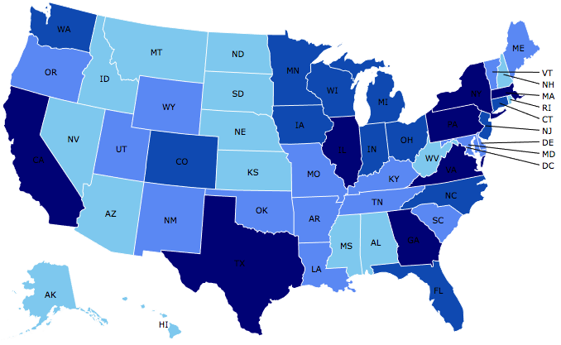
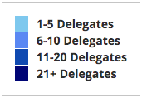
Where Are We?

Slide 5
Available NEED Topics Include:
US Economy
Healthcare Economics
Climate Change
Economic Inequality
Economic Mobility
Trade and Globalization
Minimum Wages
Immigration Economics
Housing Policy
Federal Budgets
Federal Debt
Black-White Wealth Gap
Autonomous Vehicles
US Social Policy

Slide 6
Course Schedule
The Economics of Public Policy Issues
  Week 1 (1/23): Economic Update & Central Bank Independence Geoffrey Woglom, Amherst College
  Week 2 (1/30): Federal Debt and Deficits, Kathryn Wilson Kent State University
  Week 3 (2/6): Climate Change Economics Sarah Jacobson, Williams College
  Week 4 (2/13): An Introduction to Cryptocurrencies, Geoffrey Woglom, Amherst College
  Week 5 (2/20): Saving Social Security, Jon Haveman, Executive Director NEED
  Week 6 (2/27): AI and Inequality, Geoffrey Woglom, Amherst College

Slide 7
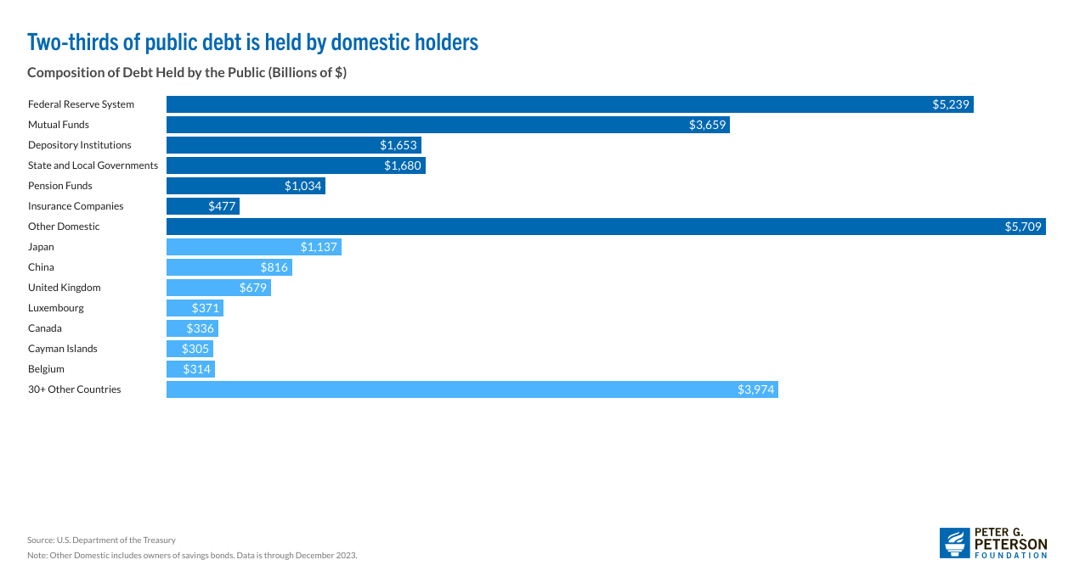
Ownership of $27 trillion Publicly Held Debt
(12/23)
US Savings Bonds, $120 billion

Slide 8
How Economists Decide How Much to Fight
Climate Change: Cost Benefit Analysis
Abating greenhouse gas emissions is costly…
… but without action, climate change damages are even more costly.
Goal is not zero emissions, but efficient level that achieves a balance.
Expected costs of reducing emissions
Expected damages from allowing climate change

Slide 9
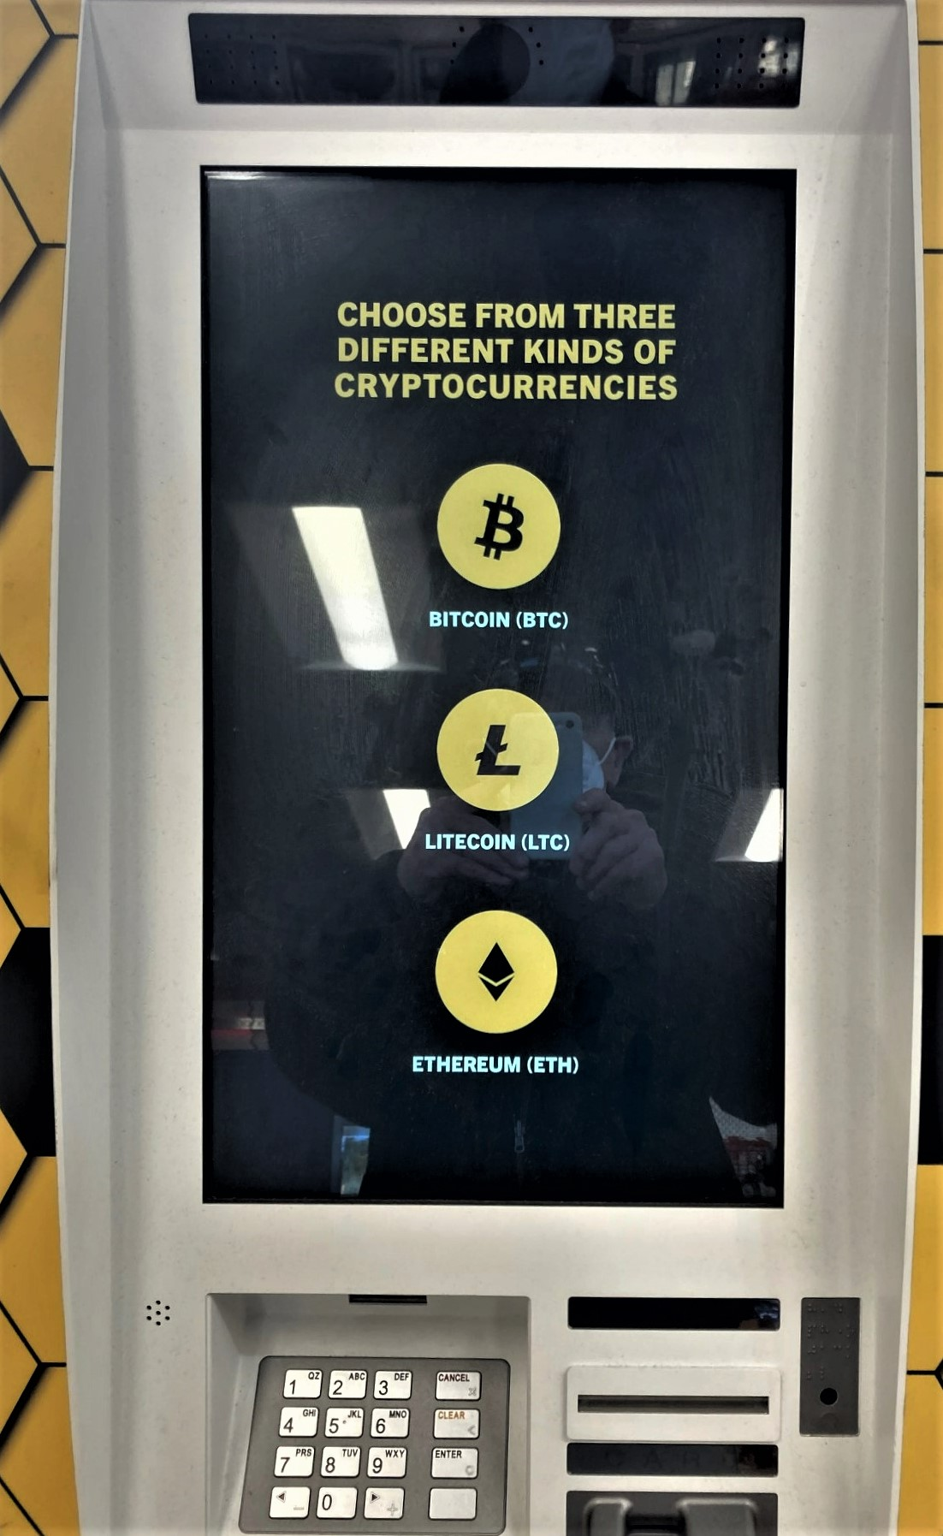
One of the Over 30,000 Bitcoin ATMs

Slide 10
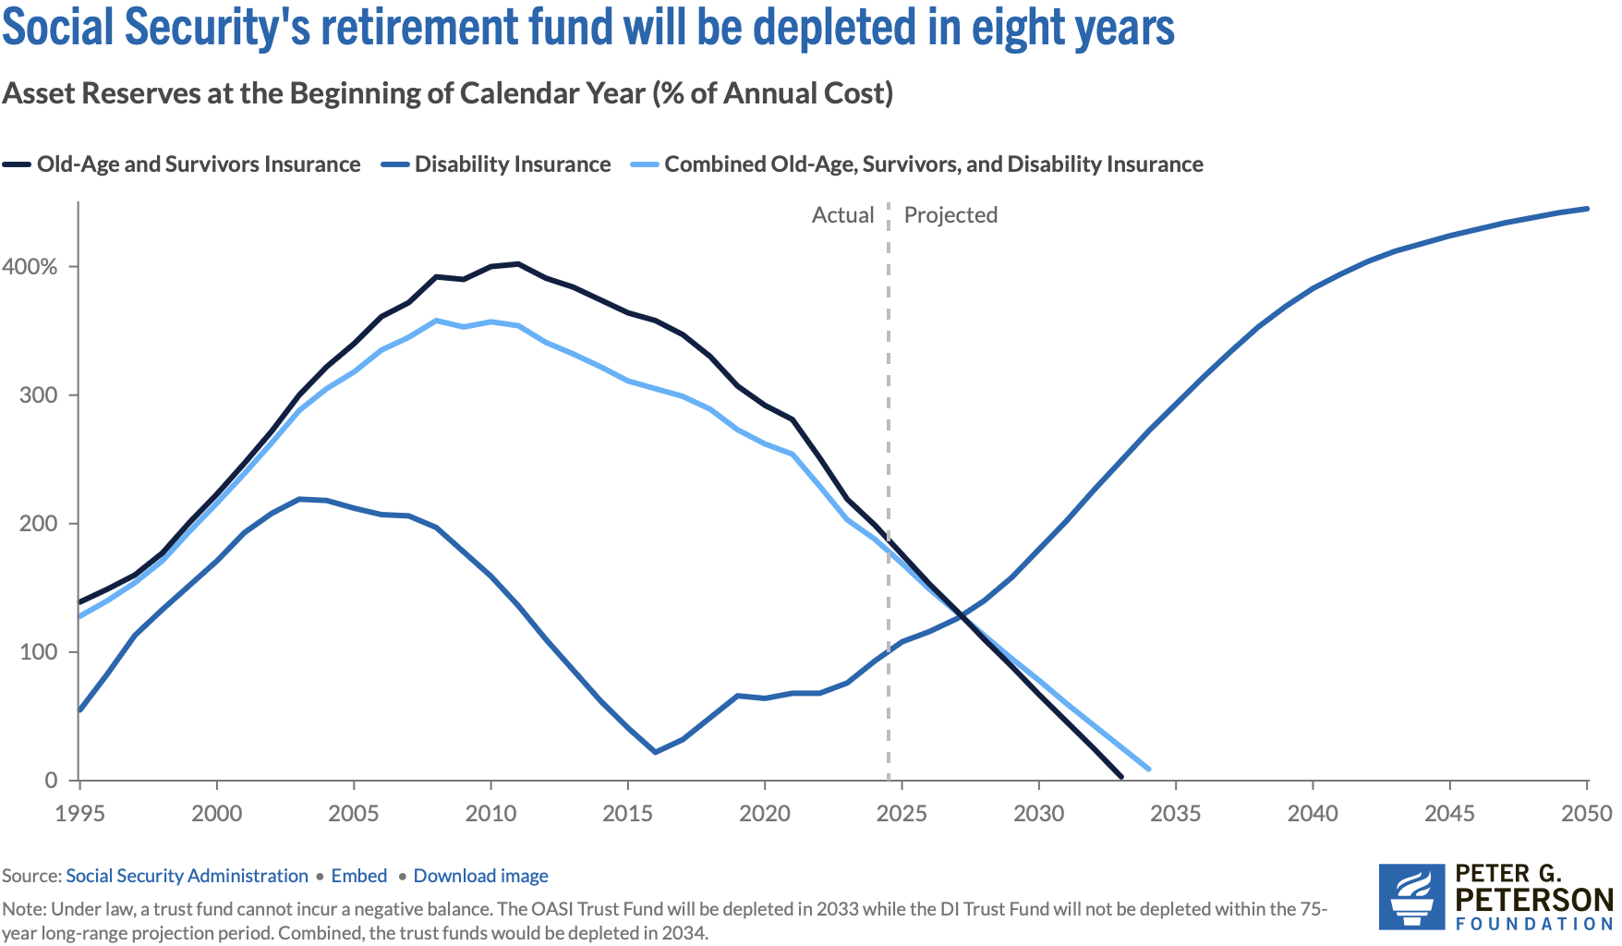
Trajectory of Funds

Slide 11
AI Is Getting “Smarter”
Eloundo, Manning, Mishkin, Rock (2023) https://ar5iv.labs.arxiv.org/html/2303.10130

Slide 12
Submitting Questions
I encourage questions. Raise your digital hand or put questions in the chat,
We will do a verbal Q&A once the material has been presented.
Slides will be available from the NEED website tonight https://needecon.org/delivered_presentations.php.
My macro site: https://sites.google.com/view/macro-current-issues/economic-update.
https://padlet.com/berkshireolli/contemporary-economic-policy-issues-icsjzm4t38pc5kr

Slide 13
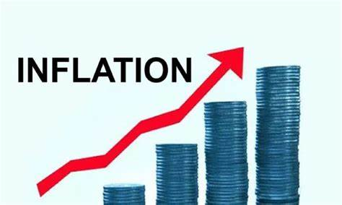

US Economy: Update
Geoffrey Woglom,
Professor of Economics
Amherst College, emeritus
January 23, 2026

Slide 14
Outline for the Talk
Overview of State of the Economy
The Importance of Stable Inflationary Expectations in the Economy’s Successful Recovery.
The Fed’s Current Policy Dilemma
Central Bank Independence and Inflationary Expectations.

Slide 15
The Goal of Macroeconomic Stabilization Policy
The Fed’s Definition:
Get the economy to the highest levels of GDP and employment while,
Keeping inflation low and stable, or at 2%
What about the climate change; poverty, health care?

Slide 16
Gross Domestic Product: 2025Q3 = $31.1 tr
$31.85
Less Imports
-$4.12
Plus Exports
+$3.37
Equals GDP
$31.1

Slide 17
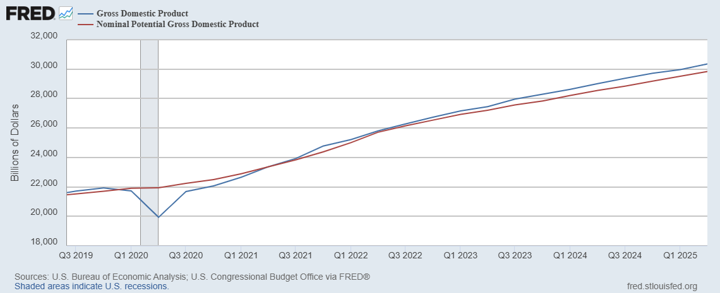
GDP and ‘Potential’ during the Recovery
Grey bar indicates recessions
Source: Fred, St Louis Fed

Slide 18
What is a Recession?
Defined by the National Bureau of Economic Research (NBER)
“The NBER's definition emphasizes that a recession involves a significant decline in economic activity that is spread across the economy and lasts more than a few months.”
Popular Rule of Thumb: Two or more, consecutive quarters where Real GDP falls. (Doesn’t always work!)
Recessions are caused by a drop in total spending (remember the consumer).

Slide 19
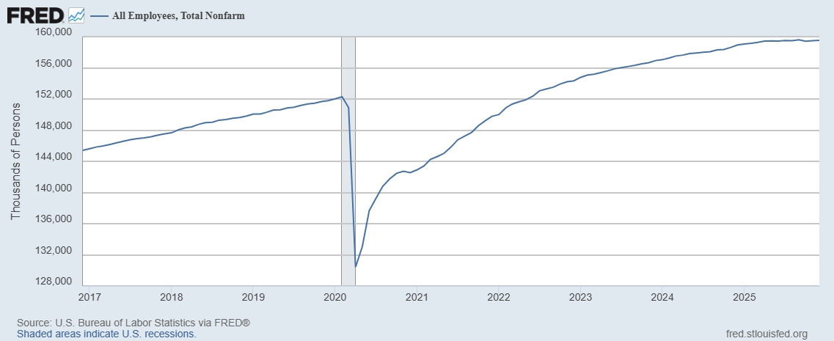
Where Have All the Workers Gone?
Aging of the Labor Force
Also, note the recent slowing in job growth.
Source: Fred, St Louis Fed

Slide 20
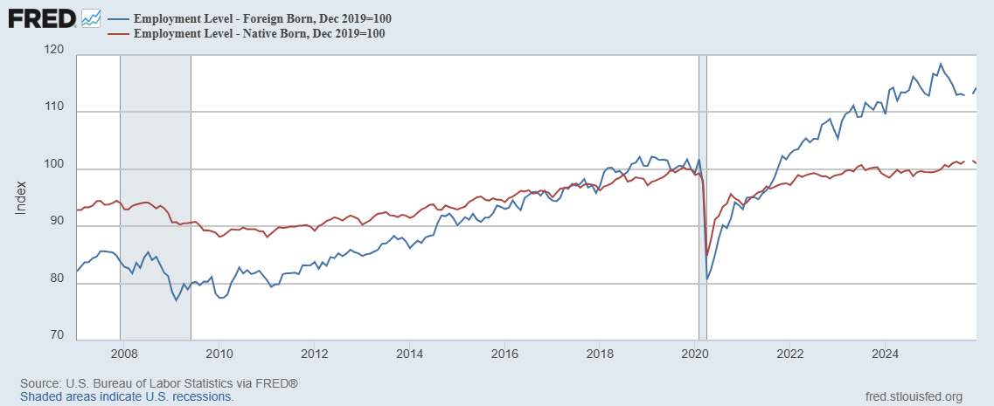
Could Have Been Worse , but for Foreign Born Workers
Between 12/19 and 3/25
NB employment fell by 100k
FB employment rose by 5000k
Since March FB employment
fell by 1100k

Slide 21
New Jobs Added per Month

Slide 22
The Kerfuffle Over the Jobs Reports
BLS conducts 2 surveys each month
  Household Survey: Unemployment Rate.
  “Establishment” Survey (workplace survey): Number of new jobs created.
August 1 Report: 73,000 jobs added July, but May and June numbers were revised down by 280,000.
Trump fires BLS director, the same day.
What is behind those “revisions?”
Want to learn more: “An Unresponsive Public is Undermining Government Economic Data,” WSJ, 9/15, at
https://sites.google.com/view/macro-current-issues/economic-update

Slide 23
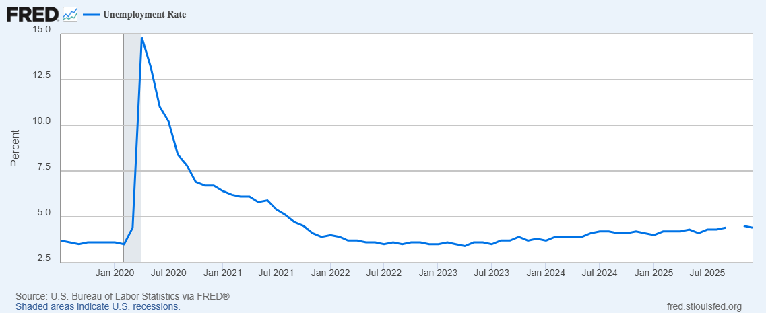
Unemployment is Near Record Lows
But, it has been rising: From 3.4 percent in 4/23 to 4.4 percent in December

Slide 24
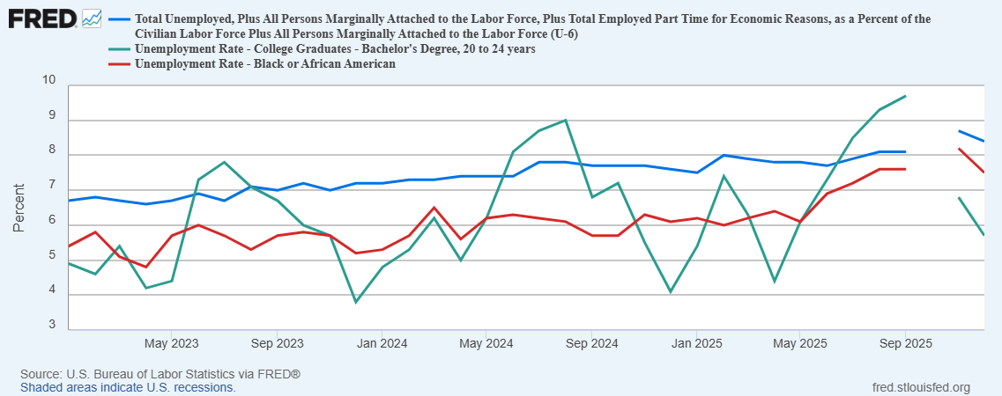
More Detail on Unemployment

Slide 25
The Real Side of the Economy is Still Good
GDP is very close to its potential.
The labor market as measured by the unemployment rate is fully recovered.
Macro Goal number 1, check
But what about goal number 2, the “nominal” side of the economy

Slide 26
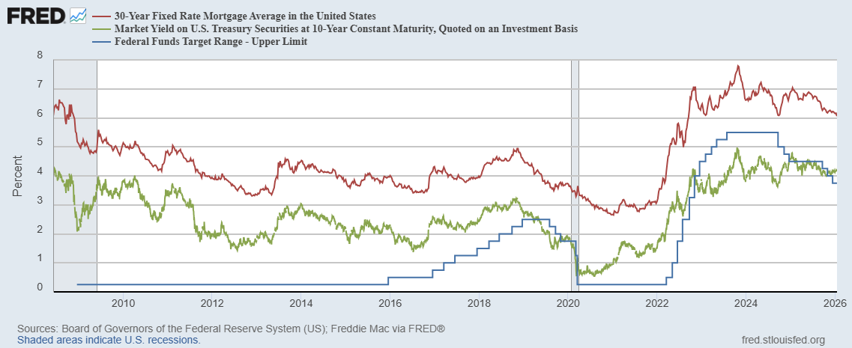
Interest Rates: Era of Falling Rates Over?
Notes:
Fed policy rate 4.5 to 4.25. Concerns with inflation

Slide 27
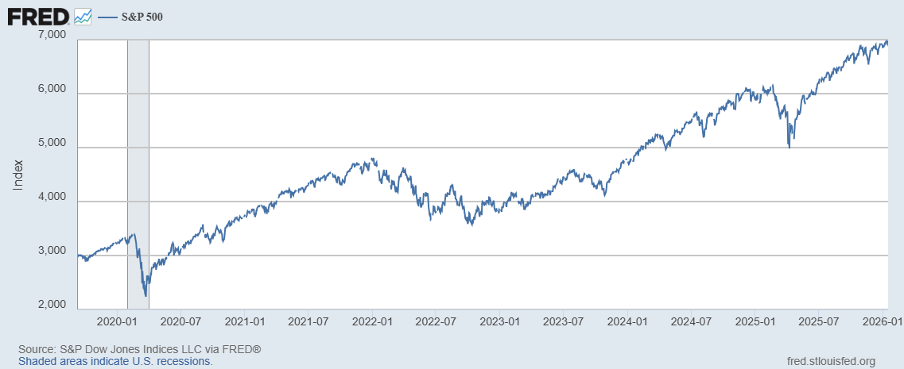
Stock Prices: Tariffs; What Tariffs?
Notes:
Since the end of 2021, lost almost 15%

Slide 28
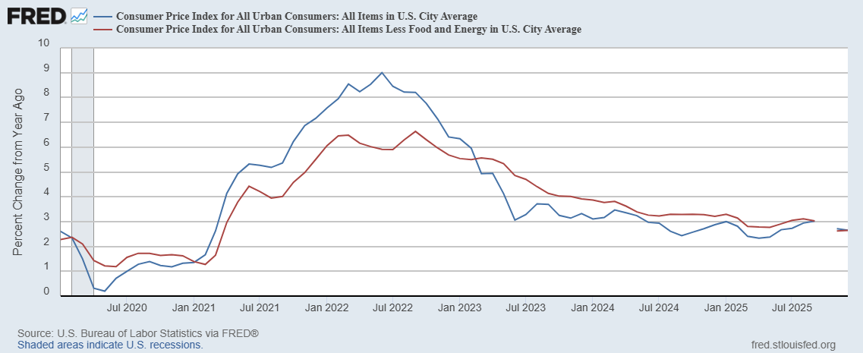
Inflation during the Recovery (CPI)
Notes:
August CPI yoy 8.3% down from 8.5 and Core 6.3 up from 6.3 in JUly

Slide 29
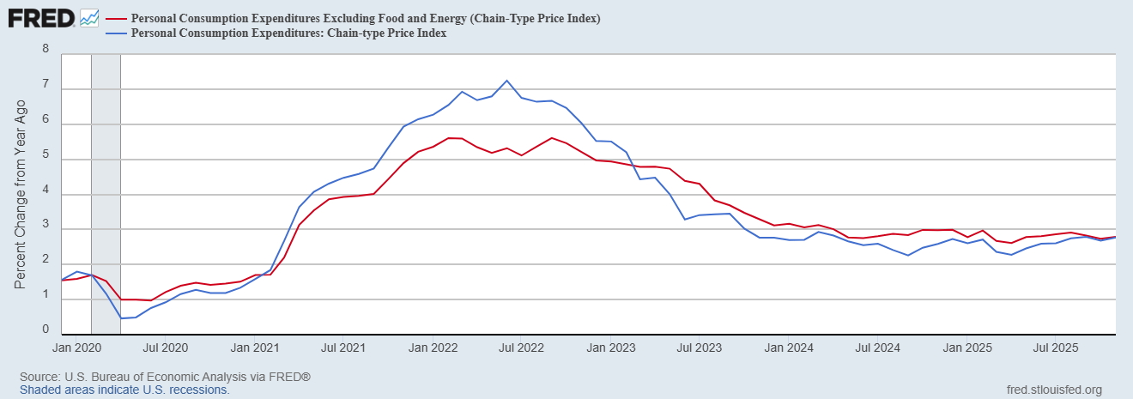
Fed’s Measure (PCE)
Inflation Accelerates 3/2021
Fed Doesn’t React until 3/2022
Progress towards the 2 % slows Spring 2024
But so far, not much sign of tariffs in inflation

Slide 30
CPI vs. PCE: Differences
CPI tends typically to be 0.3 pct point higher
November:
CPI, 2.7%
PCE, 2.8%
Core CPI, 2.6%
Core PCE, 2.8%.
https://www.morningstar.com/markets/whats-difference-between-cpi-pce

Slide 31
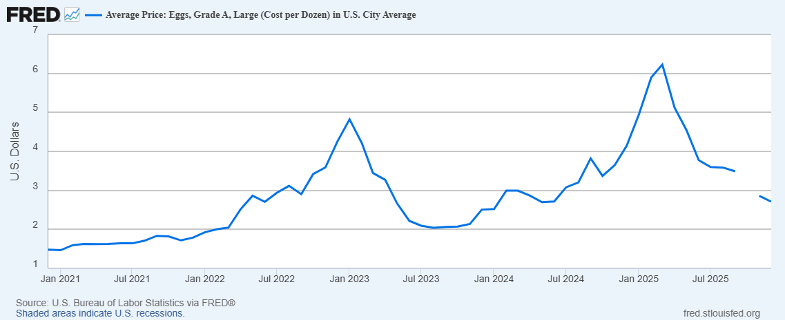
Uses of Inflation Measures
Two Reasons for Measuring Recent Inflation:
What has happened to the Cost of Living?
What is likely to happen to inflation over the next 12-18 months?

Slide 32
Wage Growth
Sources: https://www.atlantafed.org/chcs/wage-growth-tracker & BLS via https://fred.stlouisfed.org/

Slide 33
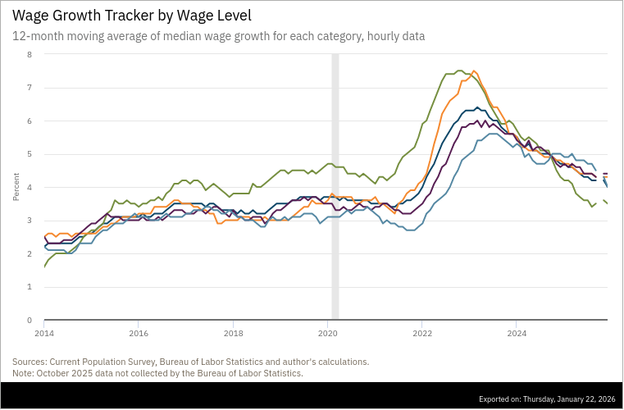
Low Wage Workers Experience

Slide 34
“Affordability”
Notes:
113 127 128 123 123

Slide 35
The State of the Economy & How We Got Here
The key indicators for judging the macro economy are all good
  Output and unemployment are close to their “full employment” levels
  Inflation is still a bit elevated, but much improved over 2023.
21-22
  Too much demand due to easy monetary policy and a fiscal stimulus which was probably too big
  COVID Supply disruptions exacerbated inflation.
23-present Monetary Policy Perfect
  Inflation has fallen substantially with small increase in unemployment, and we are close to the 2 percent target (unprecedented)

Slide 36
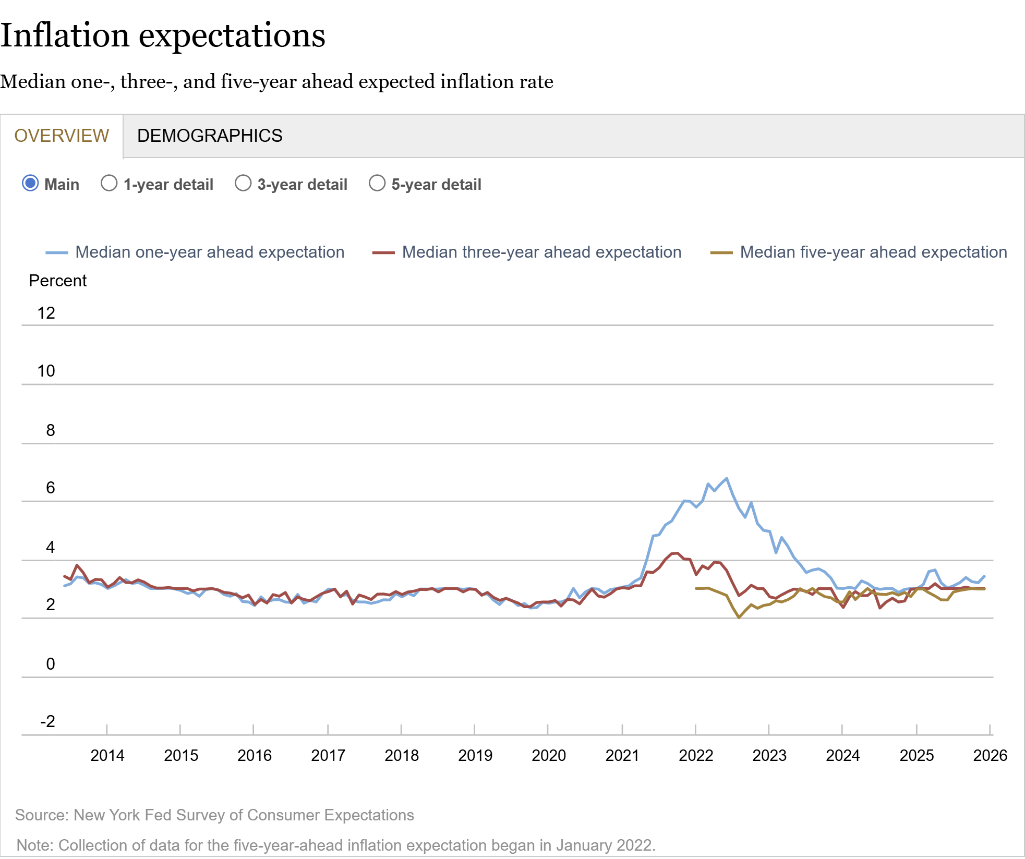
How Did the Fed Do It?
The Key to Success:
Stable Inflationary Expectations

Slide 37
The Outlook Is More Complicated
Areas of Concern:
  Consumer Spending.
  Investment Spending due to AI.
  Slowing of Employment Growth, particularly among young, blacks and BAs.
  Fiscal Policy Effects.
  Uncertainty.
  Monetary Policy: Next 4 months and the New Chair.

Slide 38
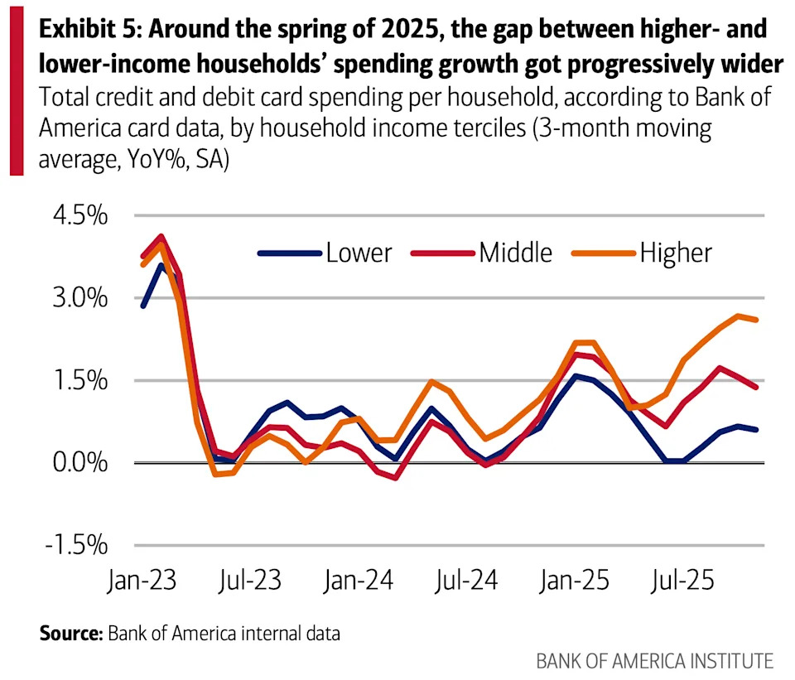
Consumption
Low-Income Consumers look vulnerable
Moody’s Top 20% account for 63% of Consumption

Slide 39
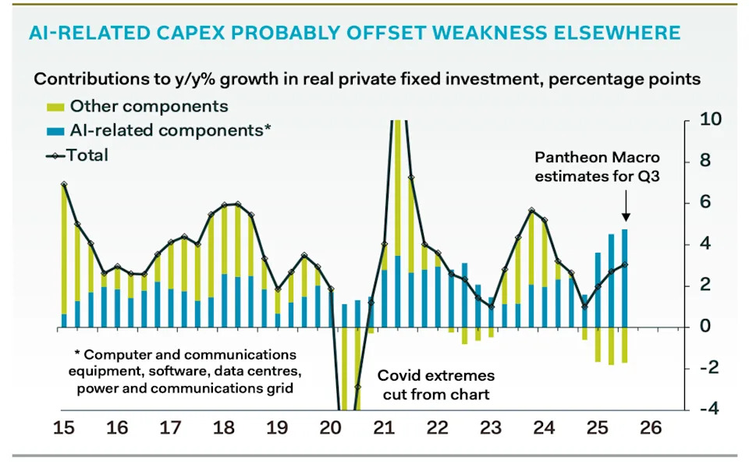
AI and Investment
AI Investment & GDP Growth
Period | GDP Growth | AI Contribution | Difference
25Q1 | 2.0 percent | 1.3 percent | 0.7 percent
25Q2 | 2.1 | 1.2 | 0.9
25Q3 | 2.3 | 0.5 | 1.8
Source: BEA & https://www.stlouisfed.org/on-the-economy/2026/jan/tracking-ai-contribution-gdp-growth
Source Parthenon: Macroeconomics

Slide 40
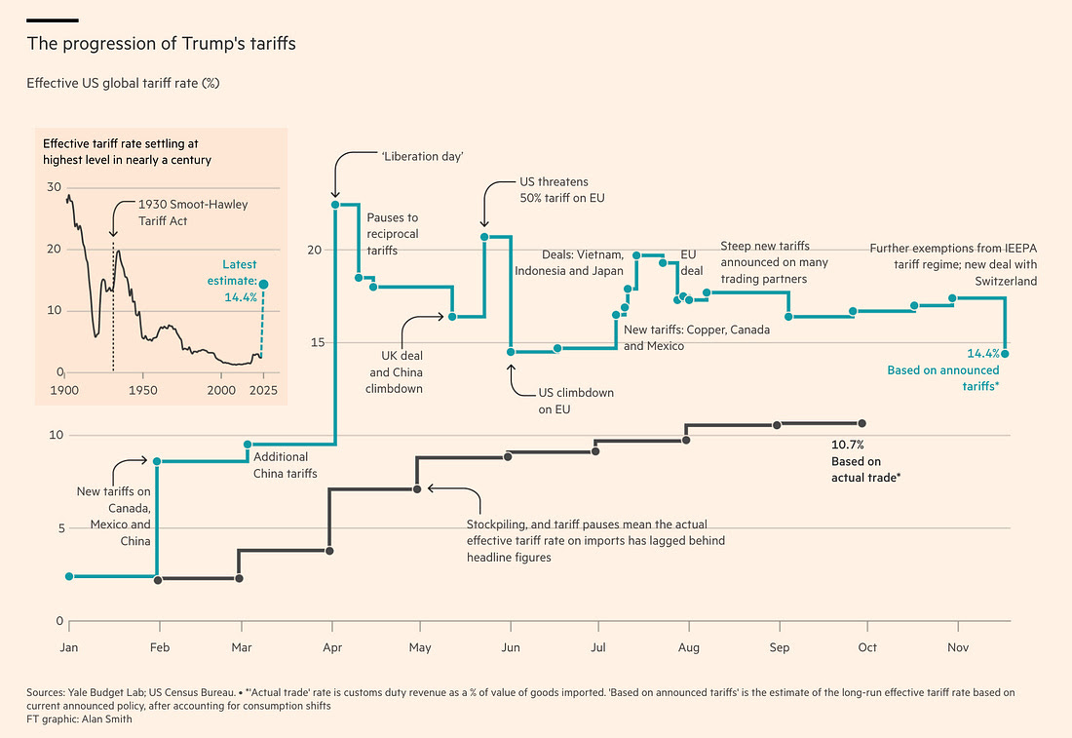
Tariffs
This Chart is Very Confusing!

Slide 41
Fiscal Policy: Tariffs

Slide 42
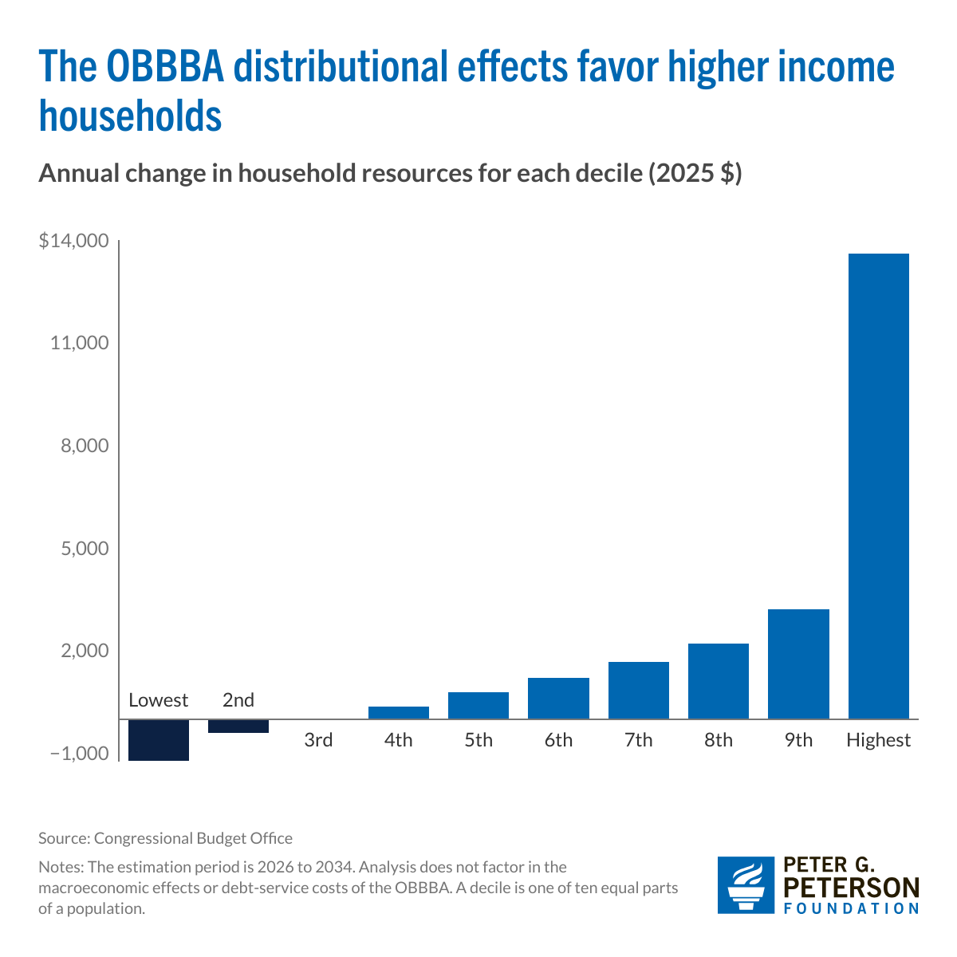
Fiscal Policy: OBBBA
Lowest: -$1,214
2nd: -$392
3rd: 0
4th: 379
5th: 797
6th: 1,211
7th: 1,673
8th: 2,213
9th: 3,208
10th: 13,622

Slide 43
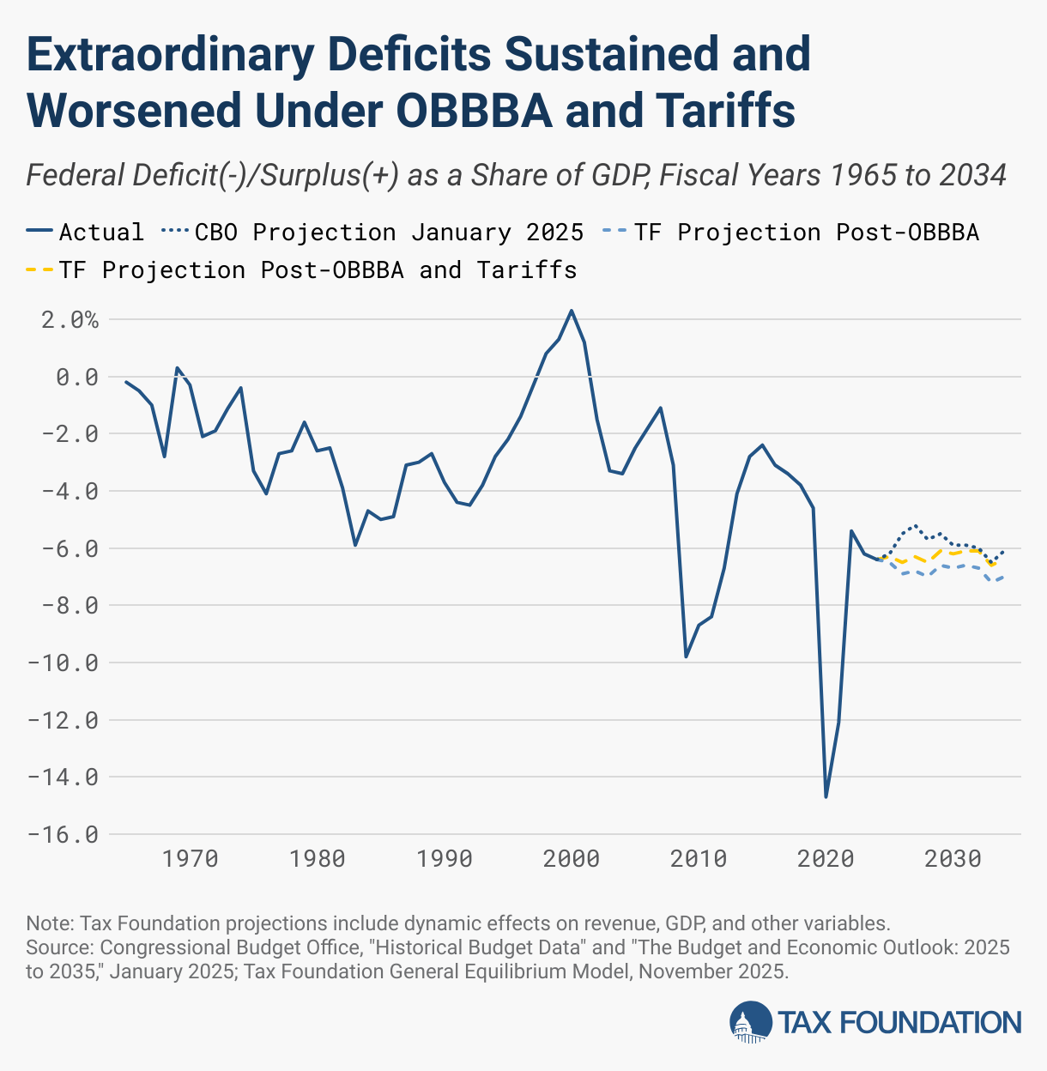
Combined Effects: Distributional
Lowest: -$2,134
2nd: -1,305
3rd: -1,076
4th: -735
5th: -541
6th: -309
7th: -30
8th: 246
9th: 922
10th: 9,751
How will these changes affect the spending of the less affluent; more affluent?

Slide 44
Combined Effects on the Budget Deficit
During 2025, tariff revenues collected were $264 billion.

Slide 45
Uncertainty
Supreme Court Decision on Legality of Tariffs
February 1st retaliatory tariffs related to Greenland and Nobel Peace Prize.
Tariff Volatility

Slide 46
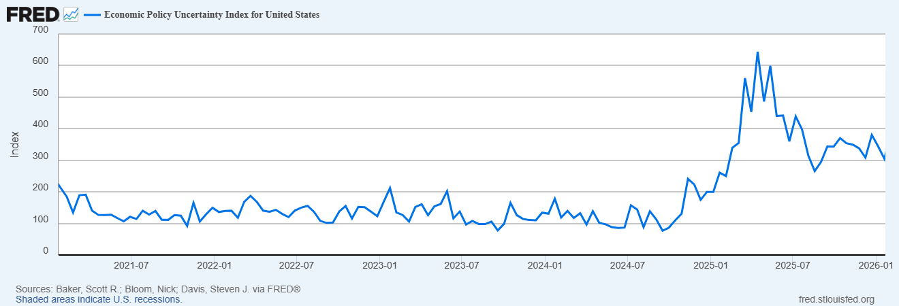
But… (Continued)
Uncertainty is Bad for the Economy’s Health (and there is a lot of it!)
How will these numbers change if:
Greenland negotiations breakdown
The Supreme Court rules Current Tariffs are illegal

Slide 47
And, then there is Monetary Policy
The Fed’s Dilemma:
To combat rising unemployment the Fed needs to lower interest rates to increase demand and spending.
To combat rising inflation the Fed needs to raise interest rates to lower demand and spending.
Successfully navigating the path between the two problems is made worse because of attacks on the Fed’s independence which have the potential to destabilize inflationary expectations

Slide 48
What the Fed Did in December

Slide 49
Central Bank Independence
Monetary Policy interest rate decisions are made by the Fed (FOMC) and cannot be reversed by other branches of government.
Federal Reserve Governors have 14-year terms.
The Chair (Jerome Powell) serves a 4-year term (which will be up next spring).
The Fed’s expenses are financed from operations; it doesn’t have to go to Congress for appropriation
The Fed is accountable to Congress and the public by:
  Congress Sets the “Dual Mandate” (but not numerical targets).
  Chair testifies to Congress.
  Policy Statement issued and Chair Press Conference after Policy meeting
  Current Policy deliberations are made available with a 6-week lag.
  All policy discussions are released with a 5-year lag.

Slide 50
Theoretical Case for Independent and Conservative Central Banks
Keneth Rogoff’s Conservative Central Banker paper (1985):
“Society can sometimes make itself better off by appointing a central banker who does not share the social objective function, but instead places "too large" a weight on inflation-rate stabilization relative to employment stabilization.”
Independent “conservative” central bank leads to “well-anchored” and lower inflationary expectations.

Slide 51
Paul Volcker: Rogoff’s Muse (?)
Volcker become Fed Chair
Volcker achieved Fed “Credibility” that it would lower inflation and keep it low. (at a substantial cost)

Slide 52
Evidence: The Low-Inflation Free Lunch
Fig. 2b Variability of Real GNP
Alesina, A., and L. Summers. “Central Bank Independence and Macroeconomic Performance
: Some Comparative Evidence.” Journal of Money, Credit and Banking 25, no. 2 (1993): 151–62.
https://doi.org/10.2307/2077833.

Slide 53
Practical Effects of this Research
Countries adopt strict inflation targeting: New Zealand (1989), Canada (1991), UK (1992), Australia and Sweden (1993)
Tony Blair’s first action as UK Prime Minister in 1997 is to remove Chancellor of the Exchequer from the Bank of England.
Eurozone created 2002 which places monetary policy out of the hands of nations’ central banks and into the hands of The European Central Bank (ECB).
Where is the ECB located?
Frankfurt Germany!

Slide 54
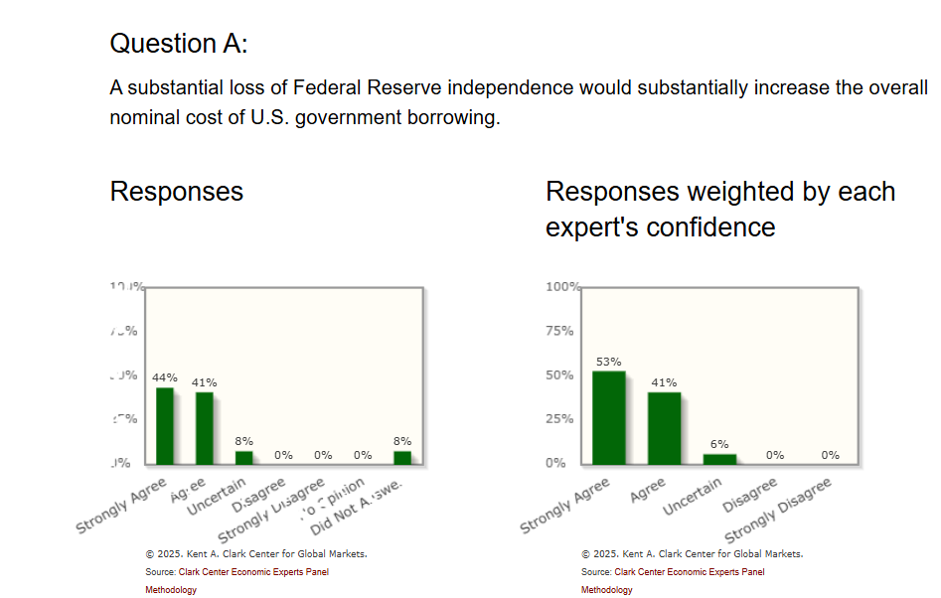
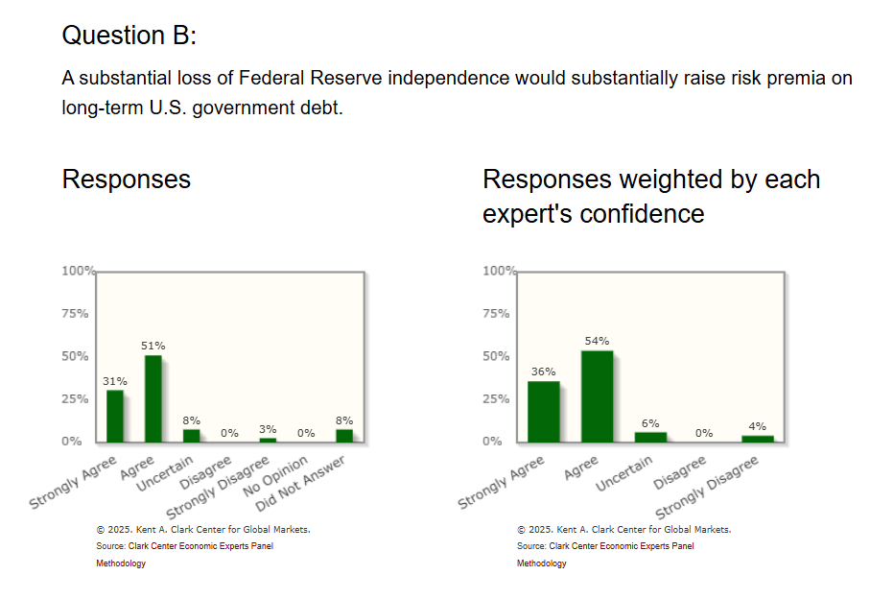
Who Says Economist Always Disagree?
https://kentclarkcenter.org/surveys/fed-independence/

Slide 55
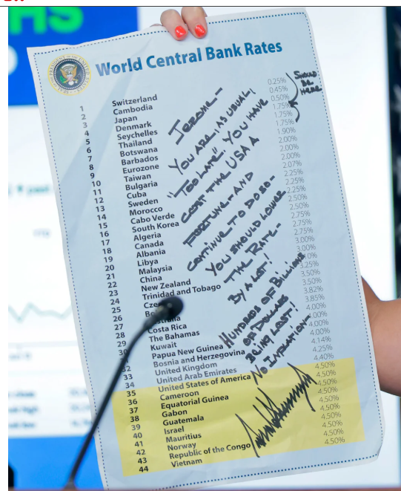
This Doesn’t Help
The irony is that the Fed would be able to lower interest rates more aggressively with no attacks.
If it appears the Fed is caving to political pressure, it will lose credibility and increase inflationary expectations.

Slide 56
An Unresolved Issue
Is Central Bank Independence Consistent with Democracy?
Things to think about: The Fed through monetary policy has the most influence on the short-run behavior of the economy. These governmental decisions are made “technocratically” and not democratically.
In the current situation should the democratic process have input in how the Fed deals with the dilemma of stagflation?

Slide 57
My Google Site
https://sites.google.com/view/macro-current-issues/economic-update

Slide 58
Next Week: Ownership of $27 trillion debt
US Savings Bonds, $120 billion

Slide 59
Let’s Hear from You!
Geoffrey Woglom grwoglom@amherst.edu
Contact NEED: Info@NEEDEcon.org
Support NEED: www.NEEDEcon.org/donate.php

